Slide 1
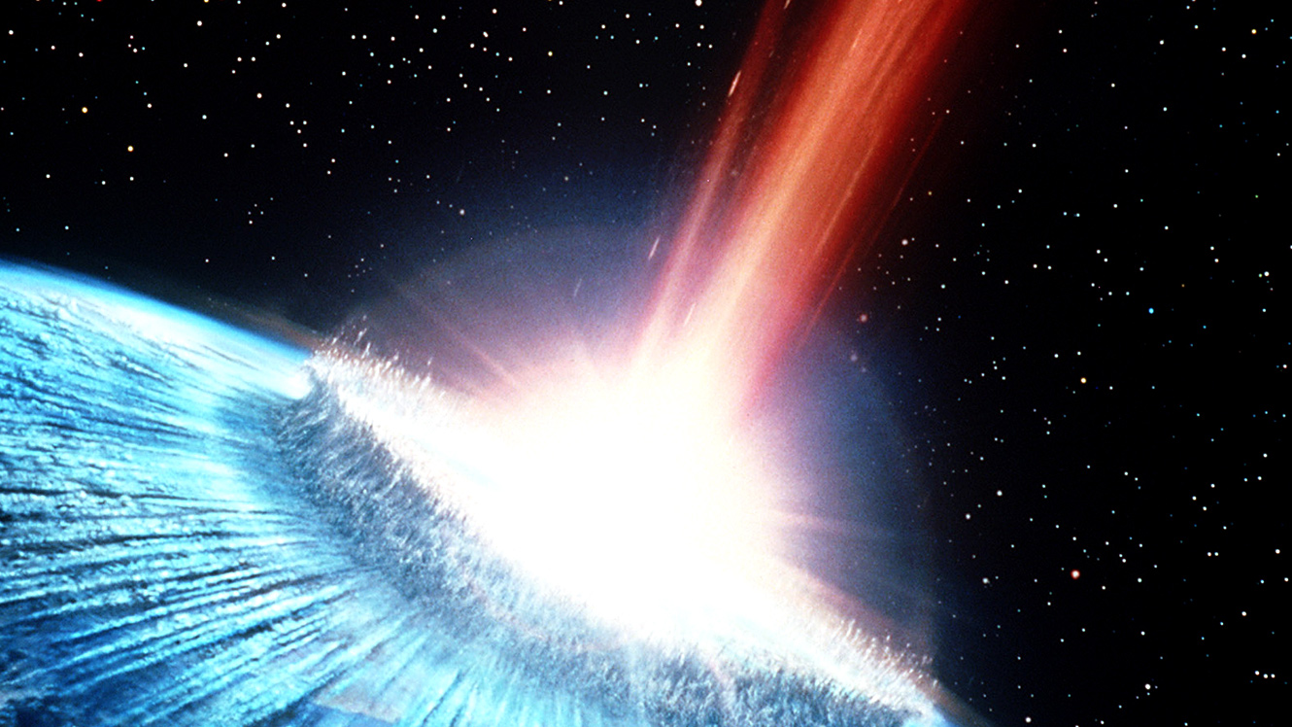
Vocabulary Impact

Slide 2
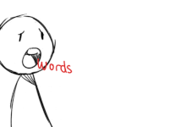
Writers use words in different ways, depending on their purpose.
Three common ways writers use words to impact meaning are:
Connotative
Technical
Figurative

Slide 3
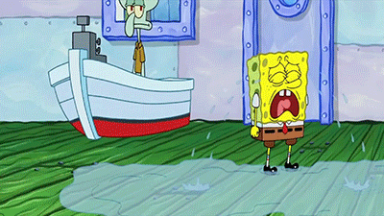
Figurative
The author uses words that are different from their literal (usual) meaning.
Example: Tears fell from her face like rain from the sky.
Explanation: In this example, the words are not meant to be taken literally. The meaning behind this statement implies that she was crying hard.

Slide 4
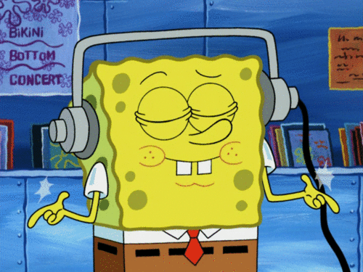
Technical
These words are used when writing about a specific subject area such as music.
Example: The conductor reprimanded the band students for playing a decrescendo instead of a crescendo.
Explanation: Decrescendo and Crescendo are words that are specific to a music class.

Slide 5
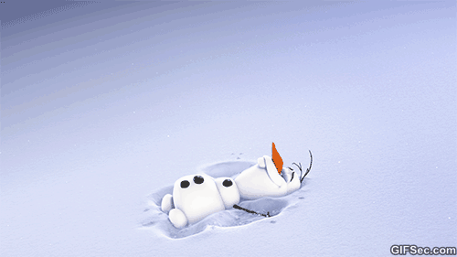
Connotative
These words have a feeling attached to them. The feeling attached to the words may be positive or negative.
Example: Would you rather trudge through the snow or stroll through the snow?
Explanation: Trudge has a negative connotation as it implies it is a difficult task. Stroll has a more positive connotation as it implies being content and taking your time.

Slide 6
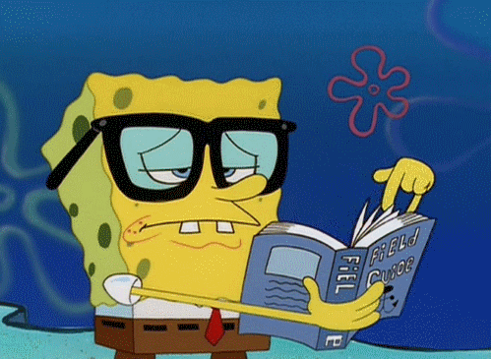
Are you Having trouble determining the meaning of words you read?

Slide 7
Helpful Strategies:
Context Clues: Read the sentences before and after the word you are trying to define. Many times, writers will give you clues to help you figure out the meaning.
Hide and Decide: When trying to figure out the meaning of a word: Read the sentence, hide the word, and replace the word with one that would make sense in the context.
Word Parts: Look for familiar word parts within the word you are trying to define. It would be helpful to look for prefixes, suffixes, and root words.

