Slide 1
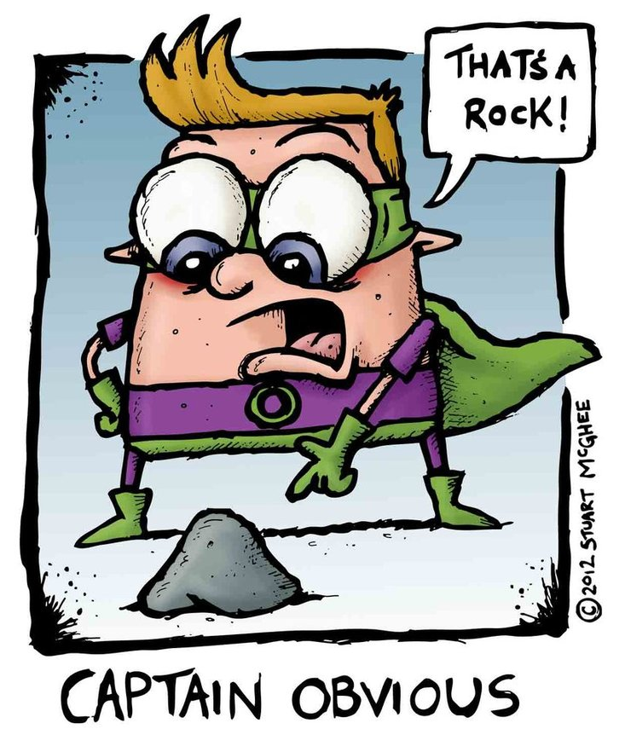
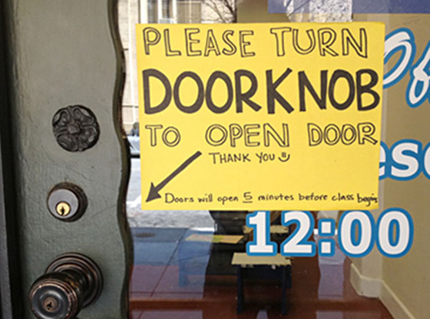
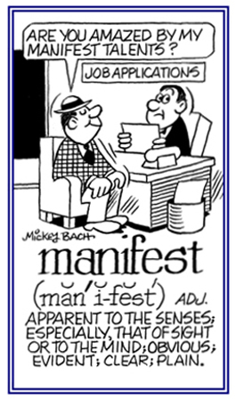
Manifest (adj)
Easily perceived by the senses
PREFIX: MAN – Hand
Synonyms: Obvious, Apparent, Evident
Sentence: Due to a manifest lack of common sense, Drew tried to climb the electric fence, and was immediately taken to the hospital.
He ____________ because of his manifest love for her.

