Slide 1
VOCABULARY: So Many Words – So Little Time

Slide 2
Why LEARN Vocabulary?
Learning, as a language based activity, is fundamentally and profoundly dependent on vocabulary knowledge.

Slide 3
It Pays Off…
Every word learned equals one more dollar in your yearly salary—unless you are a teacher.

Slide 4
Beyond the first 10,000 words used the rest are rare words, and these play a critical role in reading. The eventual strength of our vocabulary is determined not by the common ten thousand words, but by how many rare words we understand.
(Hart and Risley)

Slide 5
How Do We LeaRn New Words?
Context Clues
Content
Typographical Clues
Word Parts
Repeated Exposure
Word Walls

Slide 6
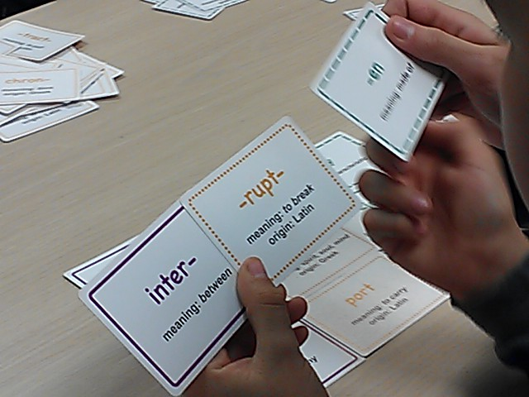
Word Parts
Looking for roots, prefixes and suffixes allows the student access to MANY unknown words.
It is best done if the introduction of such words is done school-wide; different content areas can explain their use of these words.
Multiple exposures and repetition will increase the understanding of the words.
A word is only truly learned after it is used in meaningful ways and conversation AT LEAST 10 – 15 times!
Notes:
(Read slide.)

Slide 7
Encountering
Think of a new word you have recently learned.
What was the context for that learning?
Through what means did you encounter the word?
What motivated you to learn and remember that word?
Notes:
Example: prosody. Saw it in print, heard it in presentations and in conversations, and need to use it.
Think about the process of how you learned those words and jot down a few notes. How do you learn new words? What were the circumstances? Where was the situation? How did you know you had the right meaning?
Take a few minutes to jot down your ideas. If you finish feel free to share.

Slide 8
KFC
Our method for tackling vocabulary is called Knowledge for College (KFC).
This plan involves active teaching of specific root words, prefixes, and suffixes in every classroom for repeated exposure.
KFC is used in addition to other vocabulary instruction.

Slide 9
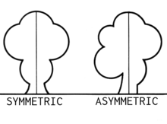
asymmetrical

Slide 10
Prefix: a- = without
Definition: without symmetry; not identical on both sides of a central line
Pronounced [ey-suh-me-tri-kuh l]
The hemline of her skirt was asymmetrical, falling diagonally from her knee to her ankle.

