Slide 1
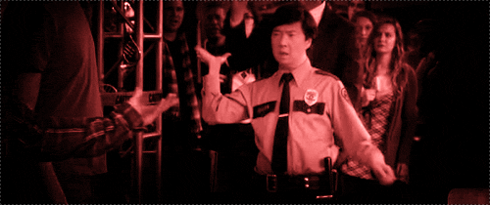
DESIST
(verb) to stand down; to cease
PREFIX: DE = Down, Out, Apart
Synonyms: Refrain, Hold Back, Abstain
Antonyms: continue, persist, finish
Mrs. McHone asked _______ to desist from _____________ during class.
The officer held out his hand, indicating that the suspect needed to cease and desist.

