Slide 1
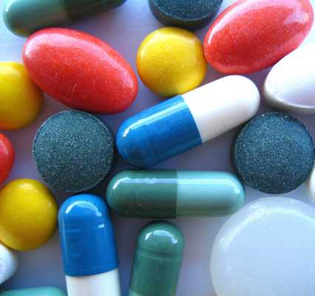
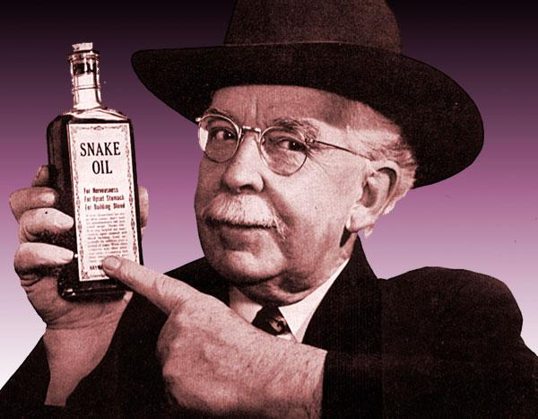
Panacea
(noun) a cure for all difficulties and diseases
PREFIX: pan = all, everyone
Synonyms: cure-all, universal cure, elixir, wonder Drug
I wish there was a panacea for ___________ because ____________.
Sentence: Everyone was hoping for a panacea for the flu pandemic that was sweeping the world.

