Slide 1
KFC Vocabulary “Knowledge for College”

Slide 2
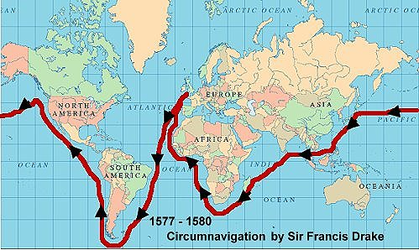
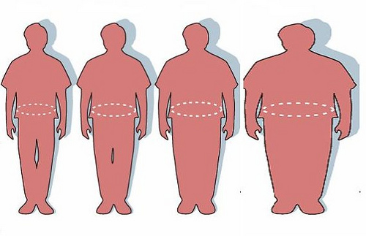
circu
Around, on all sides

Slide 3
Circumnavigate – [sur-kuh m-nav-i-geyt] verb
Definition: to go around
Sentence: Magelan circumnavigated around contininents in order to circle the globe.
Synonyms: maneuver

Slide 4
Circumnavigate

Slide 5
circu
Around, on all sides

Slide 6
Circumstances -[sur-kuh m-stans- ez] noun
Definition: the conditions surrounding and affecting a situation.
Sentence: Because of her circumstances, a broken foot, she did not have to participate in the soccer game.
Synonyms: conditions, rituals, situations, instances

Slide 7
Circumstances
Agreeing to certain conditions/terms.

Slide 8
circu
Around, on all sides

Slide 9
Circumvent -[sur-kuh m-vent] verb
Definition: to go around, or avoid by deception
Sentence: She tried to circumvent the rules and text under the table when she thought the teacher wasn’t looking. ☹
Synonyms: escape, evade, elude, outwit

Slide 10
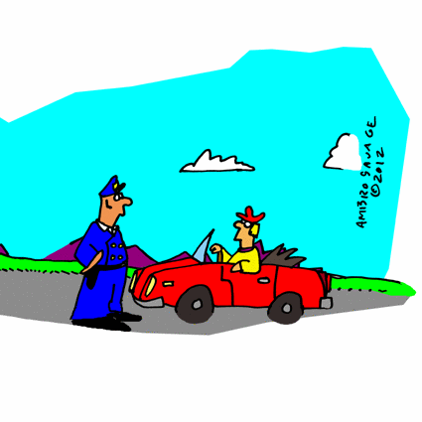
Circumvent
Trying to get around rules you don’t think apply to you.

