Slide 1
KFC Vocabulary “Knowledge for College”

Slide 2
Ben/bon
Good

Slide 3
Benevolent – [buh-nev-uh-luh nt] adj.
Definition: desiring to do good to others
Sentence: Sarah’s benevolent smile told me everything would be alright.
Synonyms: good, kind, altruistic cruel

Slide 4
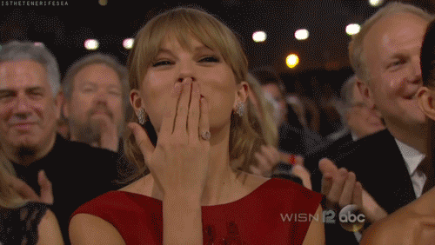
Benevolent

Slide 5
Ben/bon
Good

Slide 6
bonafide- [boh-nuh-fahyd] adjective
Definition: in good faith; genuine; real
Sentence: The couple had a bonafide copy of grandfather’s will and inherited his mansion.
Synonyms: honest, sincere, lawful false

Slide 7
Bonafide

