Slide 1
KFC Vocabulary “Knowledge for College”

Slide 2
A -
Without

Slide 3
Apathy - [ap-uh-thee] adjective
Definition: absence or suppression of passion, emotion, or excitement; lack of interest.
Sentence: Julie was apathetic towards the football game Friday night because sports aren’t her thing.
Synonyms: Indifference, uninterested

Slide 4
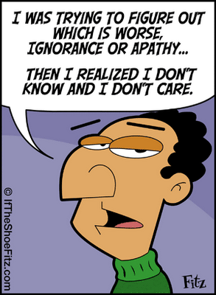
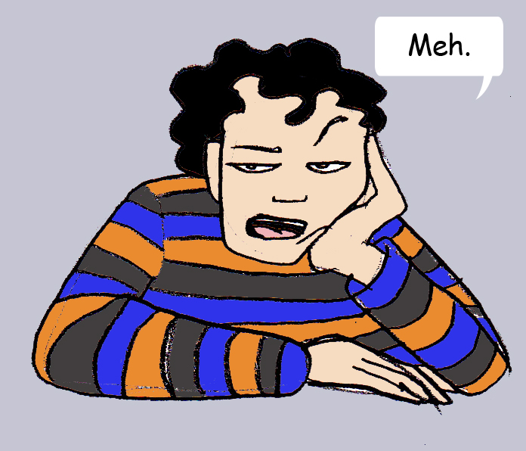
Apathy

Slide 5
A -
Without

Slide 6
Atypical - [ey-tip-i-kuh l] adjective
Definition: not typical; not conforming to the type; irregular
Sentence: Eating meat would by atypical for a vegetarian.
Synonyms: Different, peculiar, odd, unusual.

Slide 7
Atypical

Slide 8
A -
Without

Slide 9
Anonymous - [uh-non-uh-muh s] adj.
Definition: of unknown authorship or origin
Sentence: They think they are anonymous online, but I can trace them all.
Synonyms: incognito, secret, lacking identity

Slide 10
Anonymous

