Slide 1
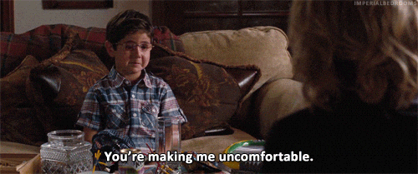
precarious
(adj.) dependent on circumstances beyond one’s control
Prefix: pre- before
Synonyms: dangerous, risky, unstable
Antonyms: secure, reliable
Sentence: The debate destroyed the precarious harmony that had recently been established in their relationship.
_____________________ put me in a precarious situation.

