Slide 1
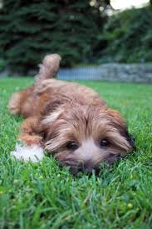
placid
(adj.) pleasantly calm & peaceful
Root: plac- to please
Other words with plac - :
placate = to soothe, calm
Synonyms: serene, tranquil, mild
Antonyms: noisy, turbulent
Her placid exterior hides______________________.
Sentence: Underneath the most placid waters, there are vicious currents and tides, and underwater volcanoes that are constantly erupting.

