Slide 1
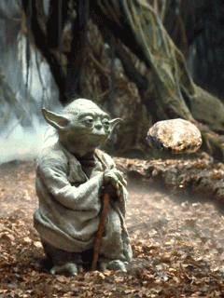
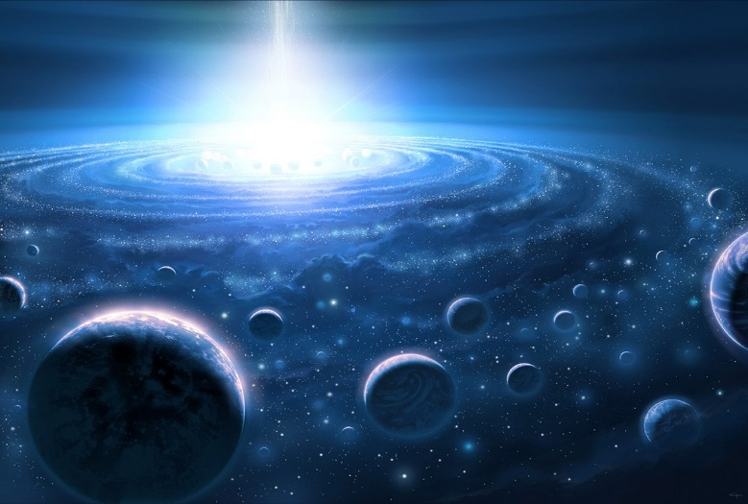
omnipotent
(adj.) having very great
or unlimited authority
or power
Prefix: omni- all
Synonyms: mighty, supreme, divine, godlike
Antonyms: weak
Sentence: Standing on stage in front of 3,000 people, she felt almost omnipotent as she nailed her performance.
The omnipotent dictator did not respect _________________________.

