Slide 1
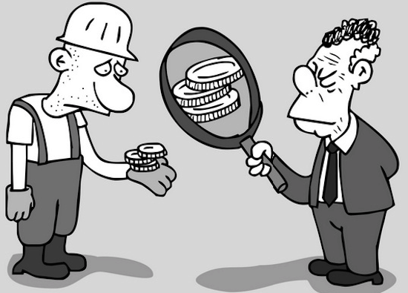
NOMINAL
Existing in name only;
negligible (very small in amount)
PREFIX: NOM/NYM = Name
I was awarded a nominal cash prize that I used to buy ________.
Synonyms: Token, Symbolic
Example Sentences:
Some stores charge only a nominal fee for the service.
The court gave me a nominal award that did not cover the cost of my car repairs.
Despite his immense wealth, Frank is a selfish man who gives a nominal amount to charities each year.
The fine for an overdue book is pretty nominal at twenty cents a day.
Canadian Prime Minister – Provides leadership and direction to the government.

