Slide 1
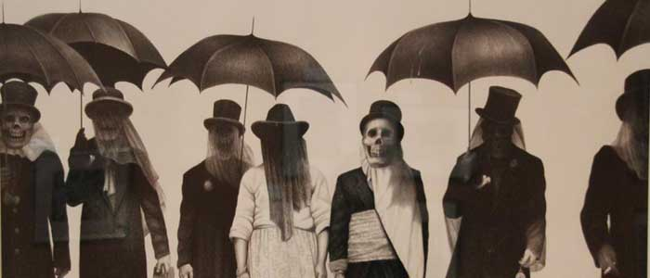
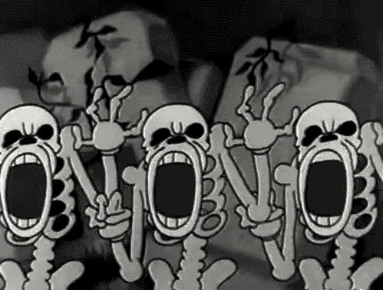
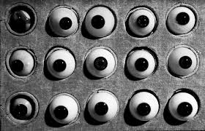
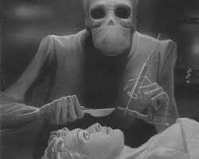
Morbid
(adj.) Susceptible to preoccupation with unwholesome matters
ROOT mor/mort = Death
Synonyms: Macabre, Gruesome, dark and twisted
Sentence: Out of morbid curiosity he camped out in the graveyard.
Out of morbid curiosity he ___________________________.

