Slide 1
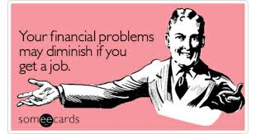
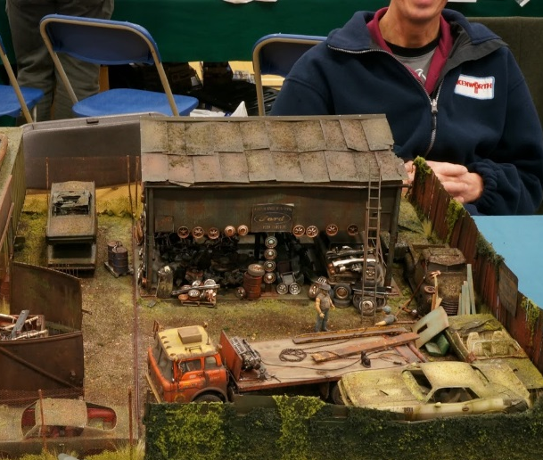
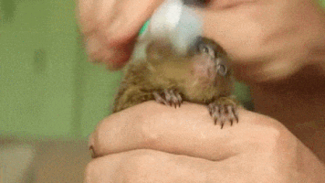
ROOT: min = small
diminish = (v.) to lessen
diminutive = (adj.) very small in size or stature
Synonyms: reduce
Antonyms: increase
Synonyms: miniature
Antonyms: enormous
Sentence: The diminutive X-37B is a quarter of the size of the old space shuttles.
The diminutive _______ was small in comparison to _____________.
Sentence: Their insults did not diminish his will to succeed.
_____ helped to diminish her fear.

