Slide 1
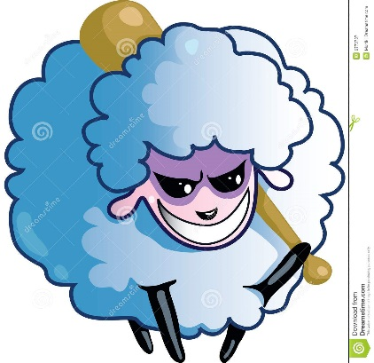
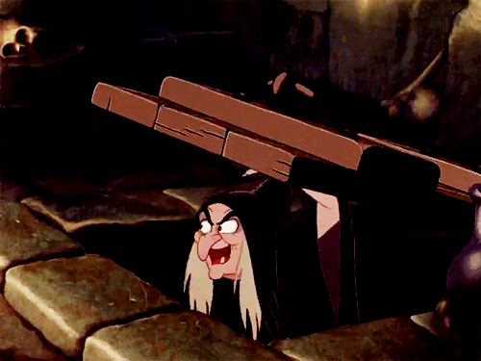
Malicious (adj)
Full of or showing malice (desire to do evil)
PREFIX: mal= bad, evil, ill, wrong
Synonyms: Malevolent, Vindictive, Spiteful
The malicious student tried to _________________________________.
Sentence: The malicious man tried to steal the old lady’s glasses so she would not be able to see.

