Slide 1
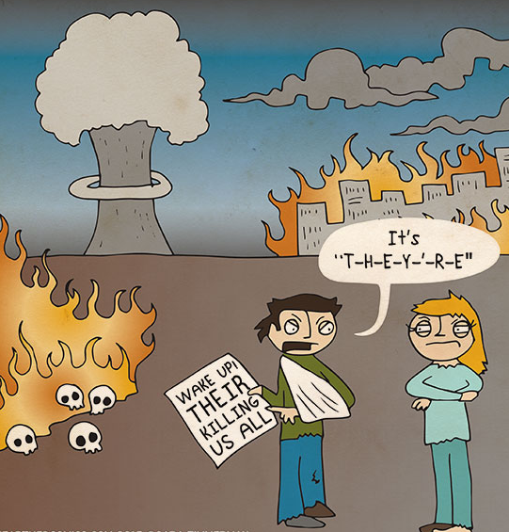
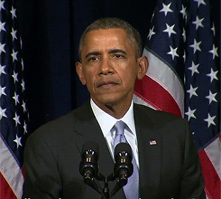
Inconsequential
(adj.) unimportant, without consequences
PREFIX: in- Not, Without
Synonyms: insignificant (not important), trivial, irrelevant (not relevant)
Antonyms: valuable, useful
Other “in-” Words:
inactive – not active
invariably – not changing
_______________ is an inconsequential reason for cheating on me!
Sentence: Mario Chalmers, an inconsequential guy on the team, is often hungry and thinks Elf is one of the funniest movies in the world.

