Slide 1
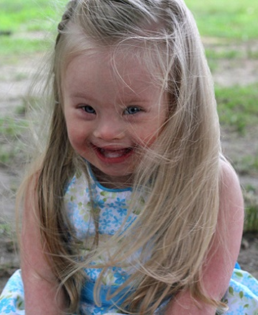
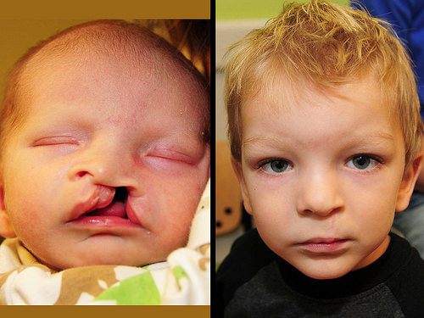
congenital
gen = (root)
birth, Race,
Kind, creation
=
(adj.) existing or as such from birth
Other GEN words:
transgender = (trans prefix = across, beyond, through) noting or relating to a person whose gender identity does not correspond to that person’s biological sex assigned at birth
carcinogenic = producing cancer
progeny =offspring, descendants
ALIKE:
born with
inbred
DIFFERENT:
hereditary
contracted
Doctors began noticing congenital birth defects in babies born from women who took the anti nausea drug, Zofran, during the first trimester of pregnancy.
-----------------------------------------------------------
Due to his congenital heart defect he could not ___________________________.
Down Syndrome Cleft palate / lip (repair) Spina Bifida

