Slide 1
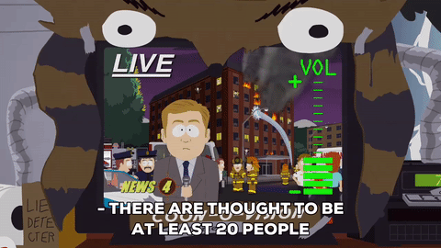
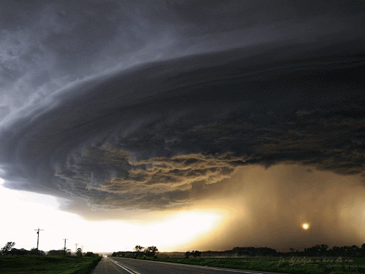
Foreboding
=
(noun) A feeling that something bad will happen
fore- = (prefix) before
Other FORE- words:
forecast= prediction of a future event foresight= the ability to anticipate & plan for future events
foreshadow= to hint at a future event forestall= to prevent by advance action
Their deaths have heightened the tensions and the sense of foreboding that something bigger and more brutal may happen soon.
I felt a sense of foreboding when ___.
ALIKE:
premonition
dread
DIFFERENT:
luck
good omen

