Slide 1
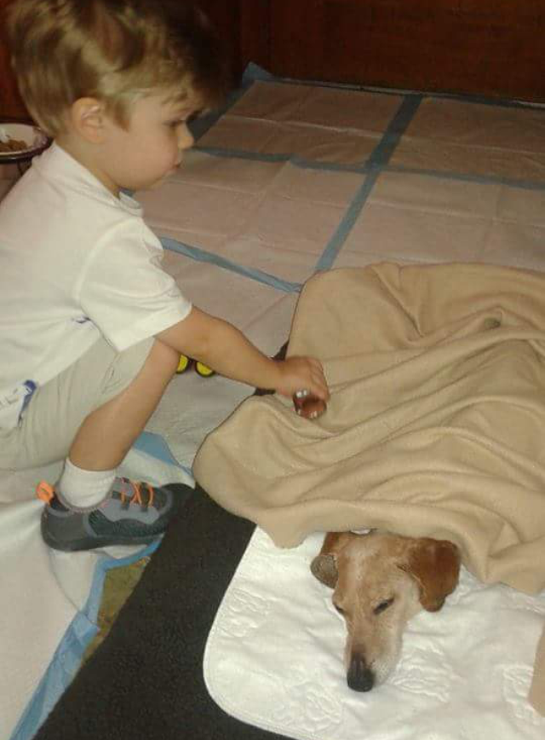
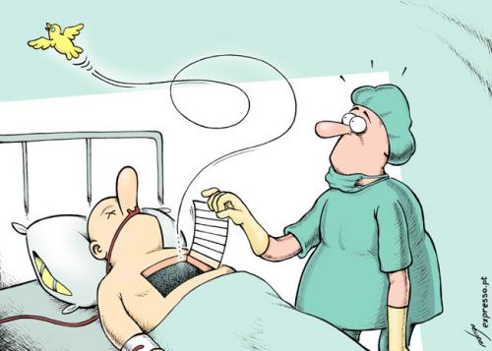
euthanasia
eu- = (prefix) good, well
=
(noun)
killing a suffering person or animal painlessly (usually one with a painful and incurable disease)
ALIKE:
mercy killing
assisted suicide
DIFFERENT:
murder, survival
I believe euthanasia is
right / wrong because _______________________________________.

