Slide 1
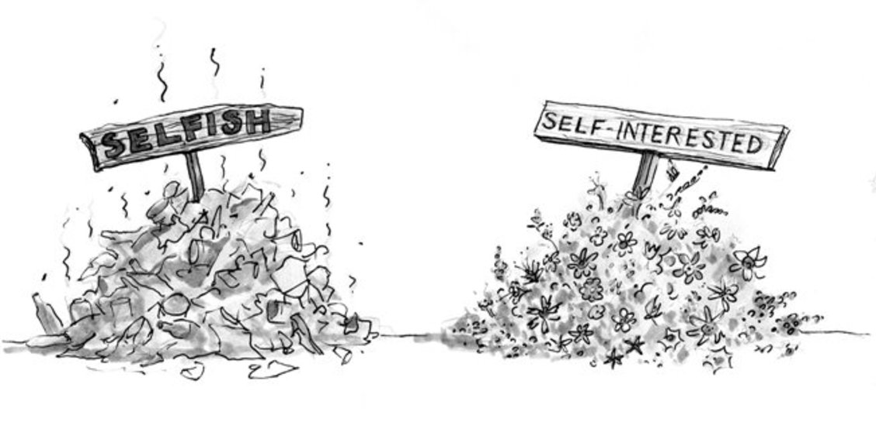
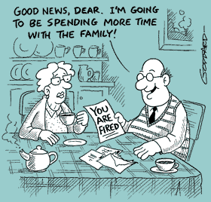
EUPHEMISM (n)
Pleasant-sounding term for something unpleasant
PREFIX: EU = good, well
Synonyms: Understatement, Polite Term
EU
A euphemism that I heard recently is _______________ which means _________________________.
Sentence: Being treated “like a girl” is a common euphemism for not being taken seriously.

