Slide 1
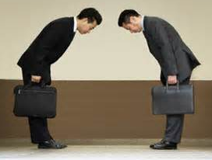
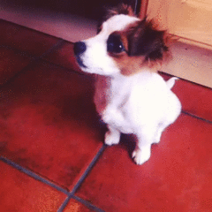
deferential
de- = (prefix) “down, out, apart”
=
(adj.) respectful; yielding to judgement
The young are deferential to their elders.
An example of deferential behavior is ________________________________.
ALIKE: DIFFERENT:
polite rude,
obedient arrogant

