Slide 1
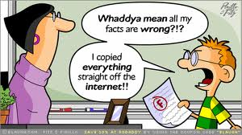
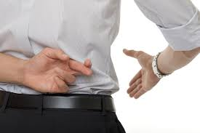
Credible
cred = (root) “believe”
=
(adj.) capable of being believed
Trustworthy, reliable, plausible,
unreasonable, dishonest
Ryan, a teacher with a good reputation and solid work history, was chosen as a credible witness for the defense.

