Slide 1
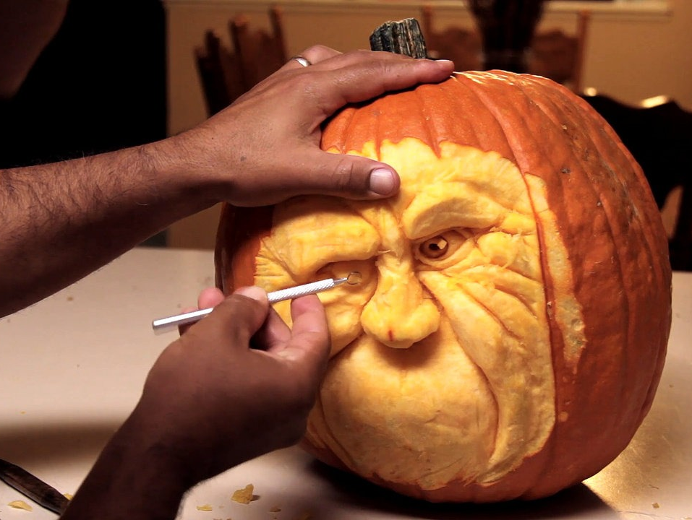
Precise
Cis = root word meaning “cut”
=
(adjective) definitely or strictly stated, defined, or fixed
exact,specific,
clear-cut
vague, undefined, indefinite
Jeff made sure his aim was precise at the arcade basketball game, in order to win the giant stuffed bear for his date.

