Slide 1
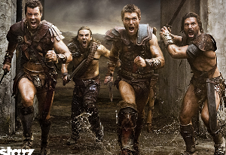
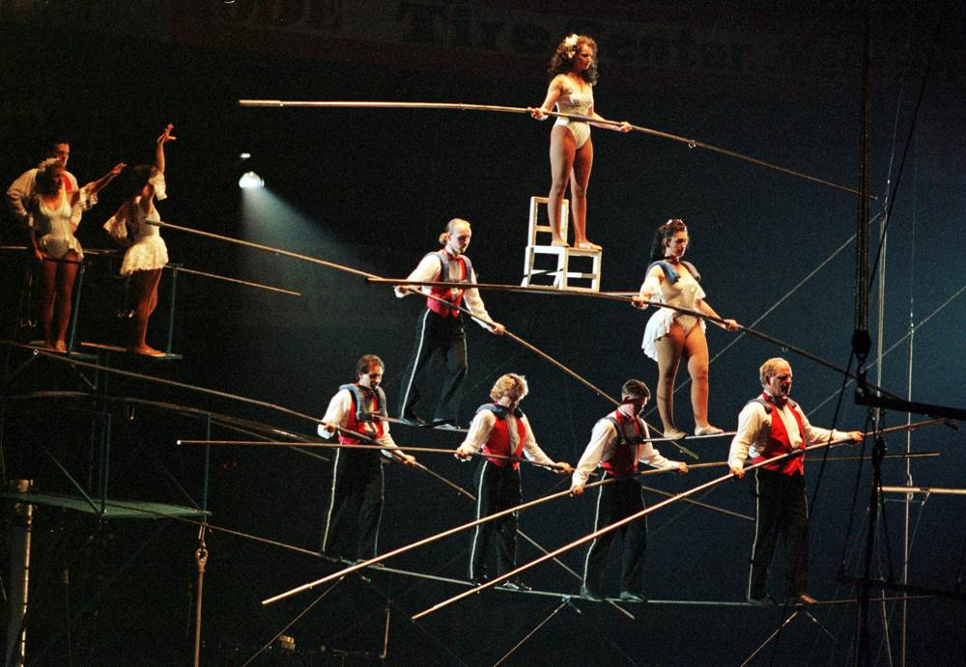
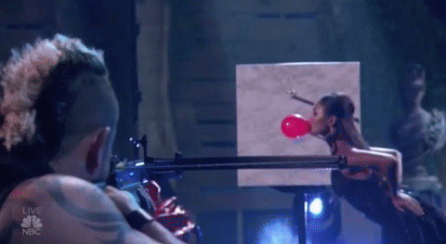
intrepid
(adj.) without fear
PREFIX: in-
not, without
Synonyms: brave, daring, bold
Antonyms: timid
The intrepid adventurers were now_______________.
Sentence: Michael was a skilled basketball player, and although he was not a great team player, he was an intrepid force on the court during games.
Other “in-” Words:
inevitable – not avoidable; will surely happen
indigent– lacking money or resources

