Slide 1
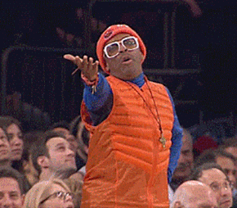
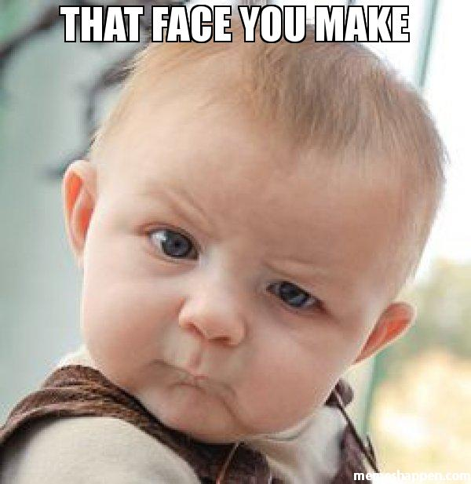
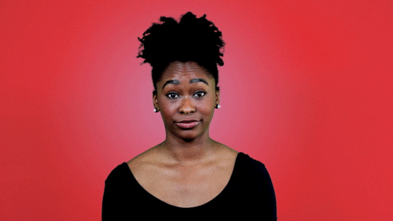
(adj.) Not willing to believe something
INCREDULOUS
Prefix: in- = not, opposite of
Synonyms:
suspicious
doubtful
skeptical
Antonyms:
sure, convinced
At the time, I
was incredulous that ________.
Sentence:
Martin showed incredulous anger when Hurricane Matthew destroyed his entire house.

