Slide 1
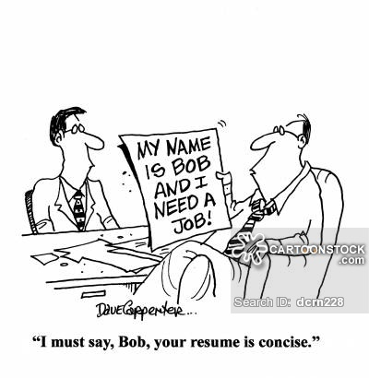
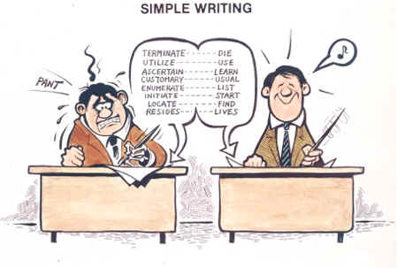
CONCISE
(adj.) short,clear,right to the point
Root: CIS = cut or kill
Sentence Starter:
Mark gave a concise excuse to _____for __________because ______________.
Synonyms: brief, condensed
Antonyms: wordy

