Slide 1
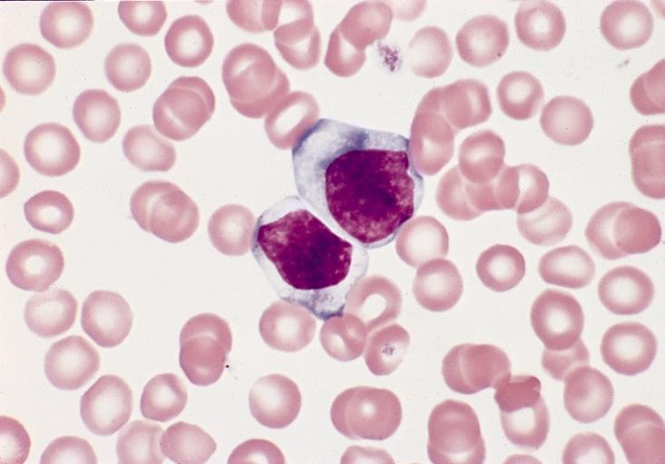
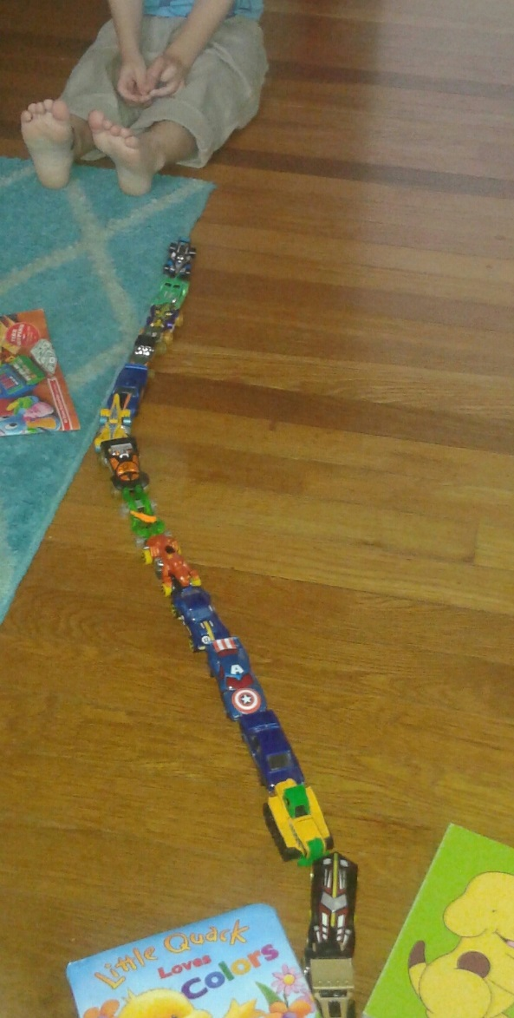
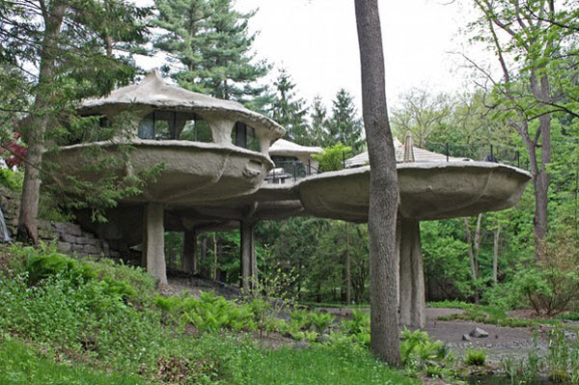
atypical
=
(adj.) not typical; not conforming
to the type; irregular; abnormal
Two atypical cells:
PREFIX = a – (not, without, lacking)
Atypical play:
Turn and talk: What is one thing that is atypical about you or your family?
An atypical house:
Atypical beauty:

